Slide 1
Optimized Sudoku Solving using
Genetic Algorithm
Team Members
Soft Computing
Shaik Kaif Sharif– 23BCE9393
Review II
Koramutla Vivek – 23BCE9396
Faculty
Prof.A Shanthi
Jonnadula Hari Kiran – 23BCE9689
Konagalla Rahul – 23BCE9193
Course Code: CSE2009

Slide 2
Project Agenda
Introduction
Literature Survey
Problem Statement
Objective
Block Diagram
Implementation
Methodology
Results
References

Slide 3
Introduction
Sudoku is a number placement puzzle that has achieved remarkable popularity in the past few years. In its classic form, the objective is to fill a 9x9 grid with the digits 1 to 9, subject to the following constraints: each row, each column, and each of the nine 3x3 subgrids must contain a permutation of the digits from 1 to 9. The initial puzzle configuration provides a partially completed grid, such as the example grid illustrated below left. The Sudoku solver must fill in the remaining grid elements to obtain a solution like the one given on the right.
Sudoku is a special case of the Latin Square [2], with an additional constraint imposed by the permutation of digits inside each subgrid. Sudoku may be generalized to allow grid sizes other than 9x9. The most convenient sizes are perfect squares (4,9,16,…), since these contain square subgrids (2x2,3x3,4x4,…), but other variations (such as a 12x1

Slide 4
Literature Survey
Authors who have applied Genetic Algorithms (GAs) to solve Sudoku,
1. Mantere & Koljonen (2006) used a GA with permutation-based encoding, fitness functions based on rule violations, and local search to refine solutions.
2. Lewis (2007) applied a hybrid GA with hill-climbing heuristics to enhance solution quality and speed up convergence.
3. Sivarama & Saikia (2010) implemented a GA with an adaptive fitness function and elitism to maintain high-quality solutions across generations.
4. Chakraborty & Pohlheim (2011) used constraint-based genetic operators and hybridized GA with constraint satisfaction techniques to improve efficiency.
5. Pereira, Tavares, & Machado (2013) developed a co-evolutionary GA that evolves Sudoku grids and solution strategies simultaneously.

Slide 5

Problem Statement
The standard approach to computer-based Sudoku solvers is a generate-and-test solution using backtracking. This strategy works extremely well for smaller grid sizes (including the standard 9x9 grid configuration), but becomes computationally intractable for larger sizes. In fact, the general problem of solving NxN Sudoku puzzles is known to be NP-complete.

Slide 6

Objective
The objective of this project is to develop a Genetic Algorithm (GA)-based approach to solving Sudoku puzzles by evolving potential solutions through selection, crossover, and mutation. The GA operates on an initial population of randomly generated solutions, refining them iteratively using a fitness function that minimizes rule violations. The aim is to achieve a complete and valid Sudoku solution while analyzing the efficiency and limitations of GAs in solving such constraint-based combinatorial problems.

Slide 7
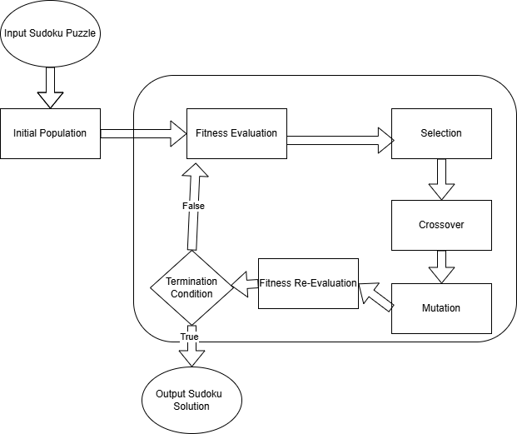
BLOCK DIAGRAM

Slide 8
Implementation
Tools & Libraries | Dataset
The Sudoku Solver is implemented in Python, utilizing libraries such as NumPy for efficient grid and matrix operations, and the built-in random module to handle the genetic processes like selection, crossover, and mutation. These tools allow the algorithm to simulate evolution over a population of candidate Sudoku solutions. | There is no need for an external dataset, as the puzzle is directly provided by the user in the form of a 9x9 grid. This grid includes some pre-filled values while blank cells are indicated using hyphens or zeros. The flexibility of user input makes the program suitable for solving a wide variety of custom Sudoku puzzles.

Slide 9
Implementation
Model Architecture | Training Process
The core architecture of the model follows the structure of a Genetic Algorithm. It begins by generating an initial population of candidate solutions that respect the fixed values from the input. Each individual is then evaluated using a fitness function, which measures the number of conflicts (duplicate digits) in rows, columns, and 3x3 subgrids. Based on these fitness scores, the algorithm selects the fittest individuals to serve as parents. Through crossover, parts of these parent grids are combined to form new offspring, and mutation is applied to introduce variation and prevent premature convergence. | The algorithm runs in cycles, known as generations. In each generation, the population is updated by evaluating fitness, selecting parents, generating offspring, and optionally retaining the best-performing individuals through elitism. This evolutionary process continues until a valid solution (with zero fitness score) is found or a maximum number of generations is reached, at which point the final solution is printed.

Slide 10
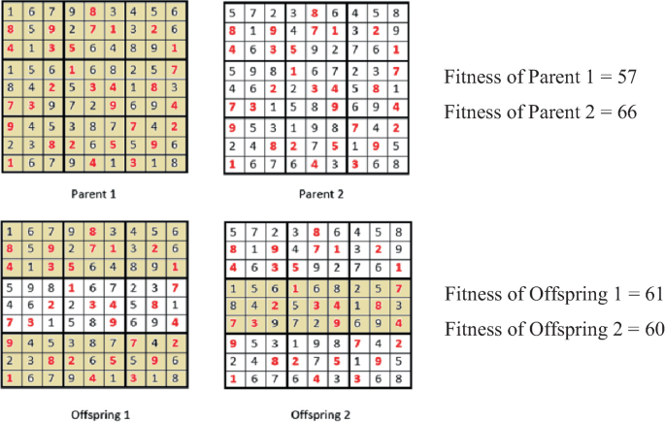
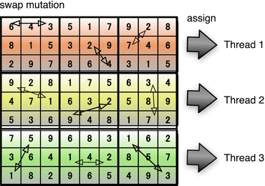
Methodology

Slide 11
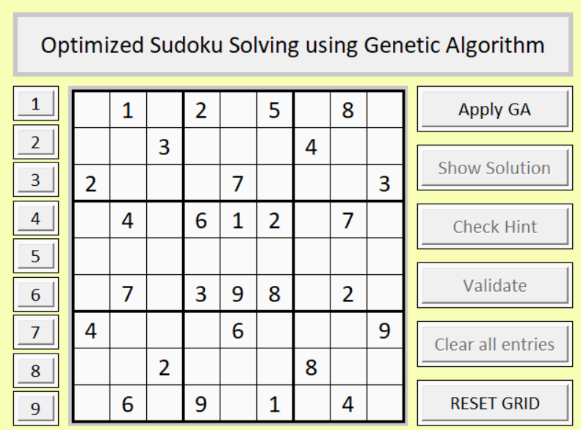
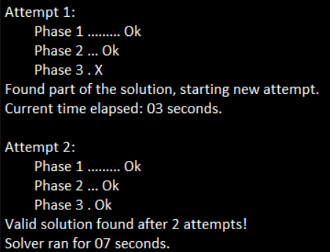
Results

Slide 12
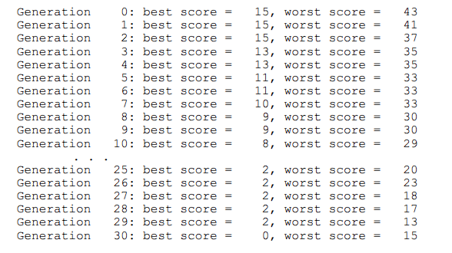
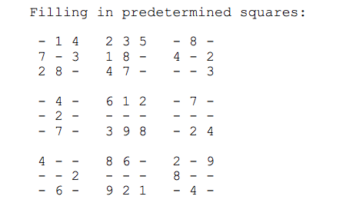
Results

Slide 13
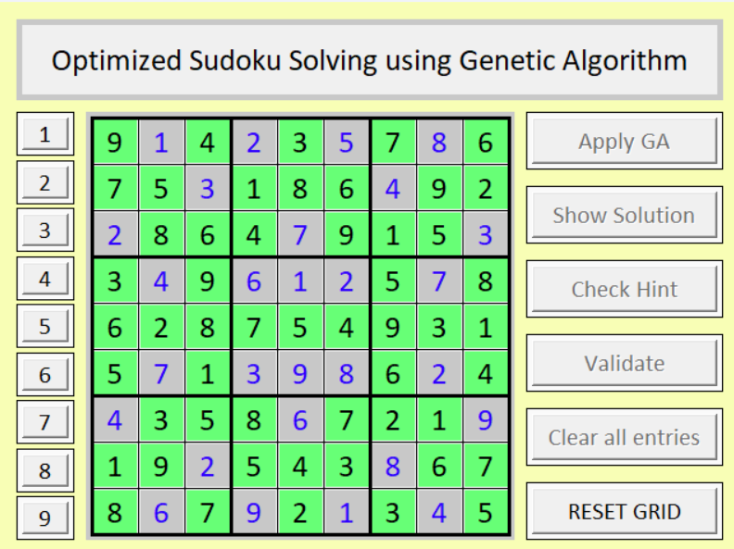
Results

Slide 14
Base Paper Link
Base Paper:
https://micsymposium.org/mics_2009_proceedings/mics2009_submission_66.pdf

Slide 15
References
1. Mantere, T., & Koljonen, J. (2006, October). Solving and rating sudoku puzzles with genetic algorithms. In New Developments in Artificial Intelligence and the Semantic Web, Proceedings of the 12th Finnish Artificial Intelligence Conference STeP (pp. 86-92).
2. Lewis, R. (2007). Metaheuristics can solve Sudoku puzzles. Journal of Heuristics, 13(4), 387-401. https://doi.org/10.1007/s10732-007-9015-5.
3. Sivarama, S., & Saikia, H. (2010). A genetic algorithm approach to solve Sudoku puzzles. International Journal of Computer Applications, 7(13), 9-14. https://doi.org/10.5120/1312-1806.
4. Chakraborty, P., & Pohlheim, H. (2011). Constraint-based genetic algorithms for solving Sudoku puzzles. IEEE Congress on Evolutionary Computation, 1-8. https://doi.org/10.1109/CEC.2011.5949706.
5. Pereira, F., Tavares, J., & Machado, P. (2013). Co-evolutionary genetic algorithms for Sudoku puzzle solving. Soft Computing, 17(12), 2243-2255. https://doi.org/10.1007/s00500-013-1072-x.

Slide 16
Key Research Papers & Contributions
1. https://ieeexplore.ieee.org/document/4424632
2. https://link.springer.com/article/10.1007/s10732-007-9012-8
3. https://ieeexplore.ieee.org/document/5949706

